Slide 1

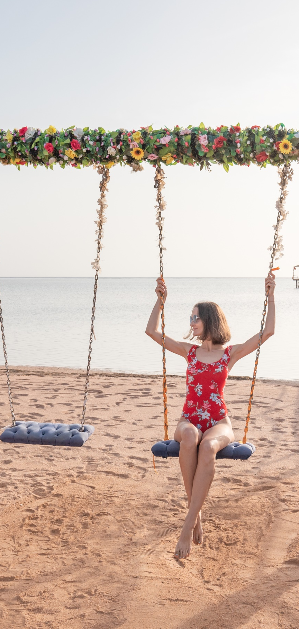

Beverages
Meals
All Kind Of Drinks
  Lobby Bar, All day long
  Terrace Bar, from 10:00 to 00:00
  Olympus Bar, from 10:00 to 18:00
  Beach Bar, from 10:00 to 18:00
  Ampitheater Bar ( Soft Drinks), from 20:00 to 22:30
  Red Sky Bar from 10:00 to 23:00& Lounge Shisha Corner ( Extra Charge ), from 12:00 to 23:00
  Golden Buddha Lounge, from 18:00 to 00:00
Ice Cream
  Beach Bar, from 12:00 to 18:00
  Red Sky Bar, from 12:00 to 18:00
Early Breakfast
  Lobby Bar, from 01:00 to 05:00
Breakfast
  Tagine Main Restaurant, from 07:00 to 10:00
  Soprano Restaurant, from 07:00 to 10:00
Late Breakfast
  Tagine Restaurant, from 10:00 to 11:00
Tea Time
  Red Sky Bar, from 10:00 to 12:00
Lunch
  Soprano Restaurant, from 12:30 to 14:30
  Capitano “ Food Court “, from 12:00 to 17:00
  Beach Bar Snack Restaurant, from 12:00 to 15:00
Coffee Break Sweets & Waffles
  Red Sky Bar, from 12:00 to 17:00
Dinner
  Tagine Main Restaurant, from 18:30 to 21:00
  Culina Fish Restaurant, from 18:30 to 21:00
  Soprano Restaurant, from 19:00 to 21:30
  Concerto A La Carte Restaurant, from 18:30 to 21:00 (pre-Reservation required with guest relation one day before. “one time per stay”
Late Dinner
  Tagine Main Restaurant, from 22:30 to 00:00
NB:
Hard Drinks are all-inclusive from 10:00 - Midnight, out of these hours drinks are against extra charge.
NB:
Meal times and locations Can be subject to change due to weather conditions or unforeseen circumstances.
ALL
INCLUSIVE FORMULA
T: +20 653360000/ +20 653464817-18-19
F: +20 653360025/ +20 653464820
H: +20 15787
E: SALES@PICKALBATROS.COM
PICKALBATROS.COM

Slide 2
ACTIVITIES
IMPORTANT TO KNOW
  Dress Code
The dress code around the hotel’s public areas and
restaurants are smart casual; gentlemen are kindly
requested to wear long trousers. Singlets, pool attire, and slippers are not permitted in the restaurant during dinnertime
  Towel Cards
In case of loss, damage, or no return to the reception
upon checkout, US$ 15 will be charged to your bill
* services with extra charge
All the above information is subject to prior confirmation.
  DJ Box Radio 10:00
  Morning Stretching 10:30
  Darts 11:00
  Dance lesson 11:30
  Aqua GYM 12:00
  Cocktail Games 12:30
  DJ Box Radio 15:00
  Step aerobics 15:30
  Beach volleyball 15:30
  Yoga 16:00
  Beach tennis 16:30
  Kids Club daily from 10:00 to 12:30 & from 15:00 to 16:30
  Check-Out Time
Check-out time is 12:00. For late check-out please
contact Reception for advice on the extra charge.
  Laundry, Dry Cleaning, And Valet Services
Laundry bags and price lists are located on the armoire shelves; if your laundry is received by 09:00, it will be returned to you on the same day at 18:00
  SPA & GYM
Gym From 07:30 to 20:00 Free Of Charge.
Swimming Pool From 09:00 to 18:00 Free Of Charge.
Sauna / Steam / Hammam ( all Spa services ) are charged extra.
NB: Kindly note that the SPA is an Adults only zone (+16).
  Safe Box
We recommend placing all your valuables inside your room safe, usage instructions are displayed on the safe box door
  Doctor “Extra Charge”
The clinic is open 24 hours, 7 days a week.
Doctors’ consultation at the clinic is available 24 hours. Should you require any medical assistance, please contact Guest Relations at the magic button. The concierge can help you obtain any prescriptions you may require
NB:
Other Beach Activities: Beach football, Beach Tennis, Tennis table & Sunset Music.
Aqua Park & Courts
Aqua park slides From 10:30 to 12:30
From 14:30 to 17:00
Tennis court From 10:00 to 22:00
Padel court From 10:00 to 22:00
Tennis table From 09:00 to 18:00
Reservation required for ( Tennis – Padel – Tennis
Table)
Reservation with Recreation team on towel center.
Hotel T-Directory
Guest Relation office (704)
Reception (700) or (0)
House Keeping (706)
SPA center (762)
Feedback:
In any Case please contact GR , which is located in Lobby area from 09:00 to 18:00.
ENTERTAINMENT
  Kid’s Movies at The Kids Club daily at 19:00.
  Mini-disco at The Amphitheater Stage daily at 21:00.
  DJ performance at The Amphitheater Stage daily at 21:30.
  Evening Show at The Amphitheater Stage daily at 22:00.
  Golden Buddha Disco From 22:30.

