Slide 1

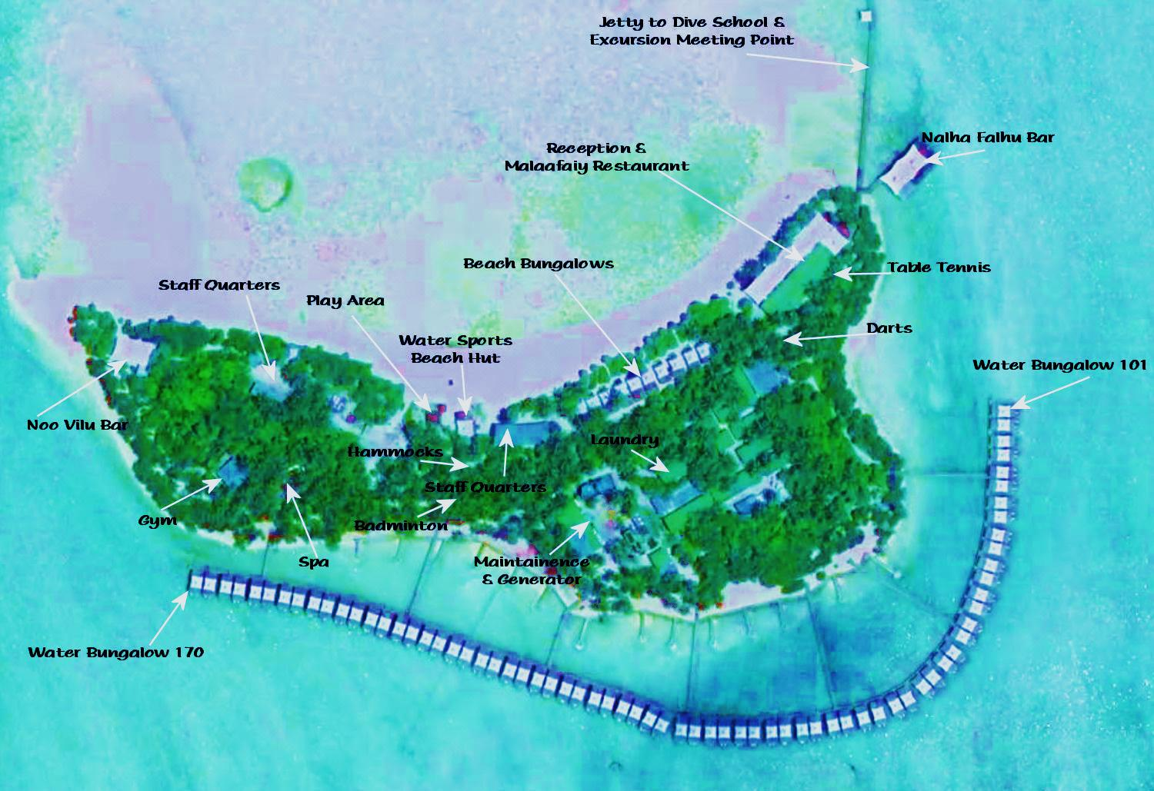
DEEP AREA
Viewing Pavilions
SHALLOW
LAGOON
LAGOON
(Overwater Bar)
(Main Restaurant)
Hill Top
beach
ADAM & EVE’S PARADISE
beach
Lover’s Deck
SHALLOW
LAGOON
105
110
165
160
155
115
SHALLOW
LAGOON
SHALLOW
LAGOON
150
145
120
140
135
130
125
DEEP AREA
DEEP AREA
DEEP AREA

