Slide 1

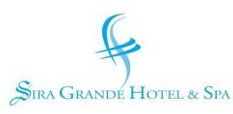
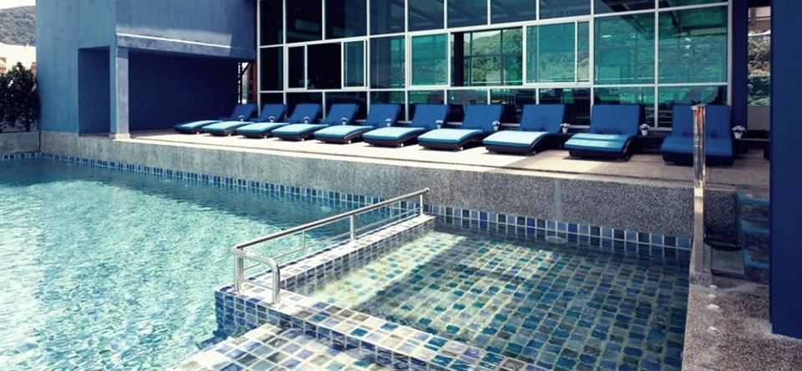
It’s your Grande style!

Slide 2
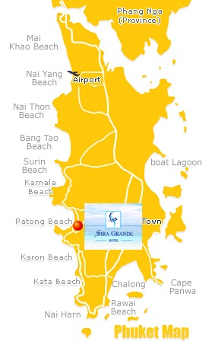
Destination
Phuket Destination Summary
Located on southern Thailand's east coast, 863 kilometers south of Bangkok, Phuket is the biggest island in Thailand, located in the Andaman Sea of southern Thailand. Neighboring provinces are Phang Nga and Krabi, but as Phuket is an island it has no land boundaries.
There are several coral islands to the south of Phuket, the Similan Islands lie to the north west, and Phi Phi Islands to the south east. Islanders engage in a lively tourist trade, catering to snorkelers and scuba divers.
Patong Beach in Phuket
Is the most popular and well-developed beach on Phuket Island. It is located on the West Coast of Phuket., Patong Beach is maybe more famous for its nightlife than the 2-kilometer beach that runs the entire length of Patong. Nightlife s centered on main area, Bangla Road.

Slide 3
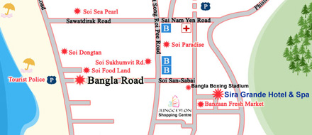
Location
Sira Grande Hotel & Spa is an ideal place
to base at Patong beach, with its wide variety
of activities and nightlife district in short
Walking distance.
Attractions/Points of interest:
Nearby to Baanzaan fresh Market
2 minutes to Jungceylon shopping mall
5 minutes to Bangla road
10 minutes to Patong beach
Nearest Airport:
Phuket International Airport – 36 Kms
Latitude 7.891500341507181 Longitude 98.30241590738297
Transfer mode:
Hotel transfer service is chargeable with the following rates
Airport Transfer (per CAR per WAY): THB 1,000 net inclusive of tax (Max. 3 adults)
Airport Transfer (per VAN per WAY): THB 1,500 nett inclusive of tax (Max. 8 adults)
Note: Surcharge 200 Baht applied for transfer service from 10 P.M – 6 A.M

Slide 4
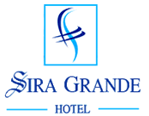
Sira Grande Hotel & Spa
99 Rooms • 8-storey Building • Rooftop Swimming Pool
Oceana Pool Bar • Siraphob Restaurant • Sira Spa• Gym

Slide 5
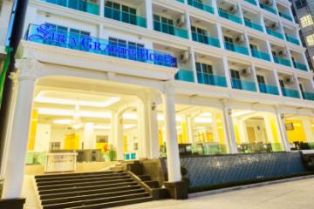
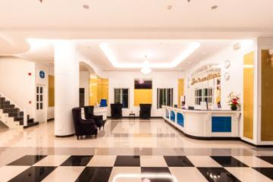
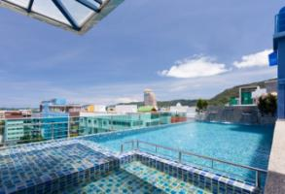
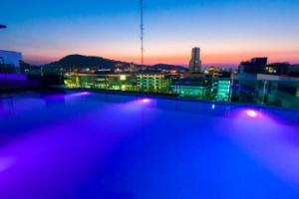
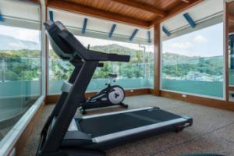
Hotel Gallery
Hotel Exterior Hotel Lobby
99 Rooms • 8-storey Building • Rooftop Swimming Pool
Oceana Pool Bar • Siraphob Restaurant • Sira Spa• Gym

Slide 6
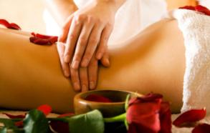
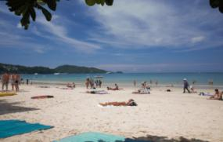

Unique Selling Points
• Located in the center of Patong beach being close to the biggest shopping mall and in short walking distance to the famous nightlife street and Patong beach
• Rooftop swimming pool with pool bar and air conditioned lounge
• 3 star and half hotel with fitness room and function room facilities.
• Free unlimited high speed Wi-Fi in all areas
• Spa and wellness center

Slide 7
Accommodation
Sira Grande Hotel & Spa takes hospitality design to the next level with an exclusive fusion of modern and contemporary Thai interior elements. A choice of three different accommodation categories is available promising the ultimate in comfort and convenience.
No effort has been spared in making sure that each and every one of our guest experience top comfort while staying with us.
Each room is designed with the essentials needed to ensure your stay here in Sira Grand is special, from in room furniture to the en-suite toilet, all amenities are included, all our guests have to do is to move in and enjoy.
Room Type | No of rooms | Configuration | Room Measurement
Relax room with window | 24 | 1 king-sized bed Or 2 single beds | 25-27 sqm.
Relax room with Balcony | 72 | 1 king-sized bed Or 2 single beds | 28 sqm.
Refine room with Balcony | 3 | 1 king-sized bed | 32 sqm.
Total: 99 rooms
ALL ROOM AMENITIES
•40” Flat-screen cable TV
•Individual Air Conditioner
                •Electric safety box
                •Telephone
•Coffee & tea making facilities
•Mini- fridge (unstocked)
• En suite bath room with speaker
•Bathrobe & slipper, umbrella
•Rain shower
• Built-in Hair dryer
•Unlimited Wi-Fi access

Slide 8
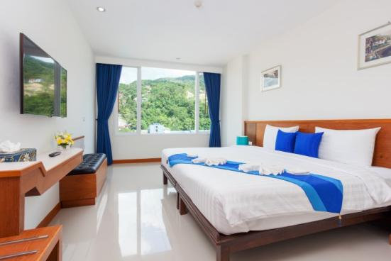
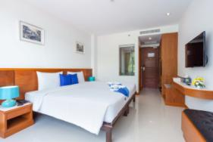
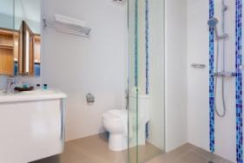
Relax Room with Window (25-27 sqm.)

Slide 9
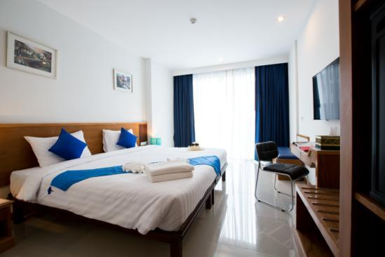
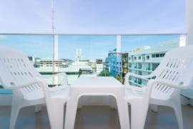
Relax Room with Balcony (28 sqm.)

Slide 10
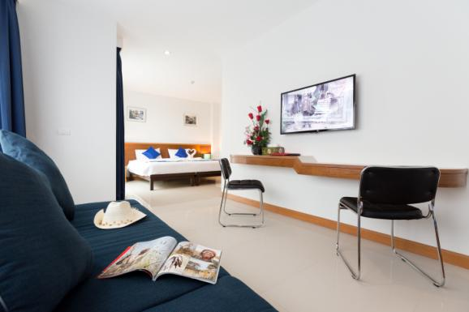
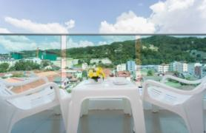
Refine room with Balcony (32 sqm.)

Slide 11
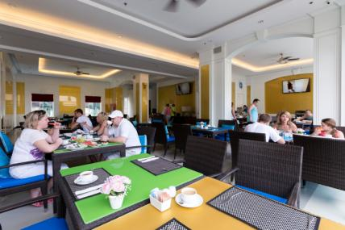
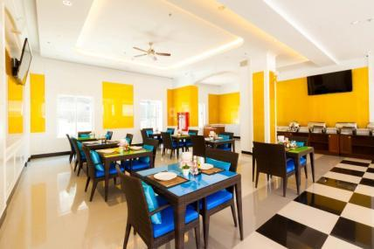
Food & Beverages
Siraphob Restaurant
Opening Hours: 06.00 am – 03.00 pm. / Seating Capacity: 80
Breakfast is the first and most important meal of the day! Here at Sira Grande, we want all of our guests to enjoy it most! With hot dishes, Salad bar, Asian and western dishes, sausages, ham, fresh eggs done it your way, fruit juices, cut fruits, toasts and top it with a cup of hot coffee or tea; it is a grande way to start your holiday!

Slide 12
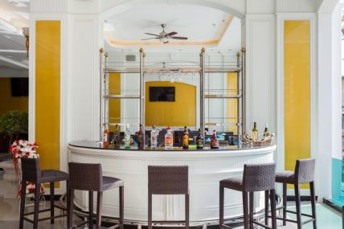
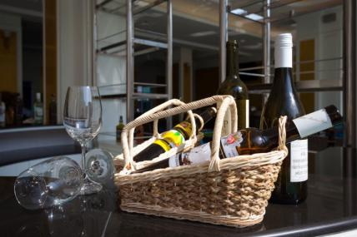
Food & Beverages
Lobby bar
Opening Hours: 06.30 am – 10.00 pm. / Seating Capacity: 10
Not planning to go anywhere? Why not hang out at our lobby bar for a few refreshing and cool drinks – cocktails, fruit juices, fruit shake, soft drinks or if you like, beers. its all available here!

Slide 13
Food & Beverages
Oceana Pool Bar
Opening Hours: 10.30 am – 10.00 pm. / Seating Capacity: 60
Enjoy the Grande Stylish creation from our In-house bartender and other International spirits, from our Oceana Pool Bar at Infinity Pool of Sira Grande Hotel & Spa or relax and enjoy the breezes from Patong Beach area while sun-bathing at our outdoor loungers, zipping into tropical homemade cocktail. Rooftop Dine & Music Lounge serves a wide variety of Cocktails, Wines, Beers and premium brands of Liquor with stylish dining menu.

Slide 14
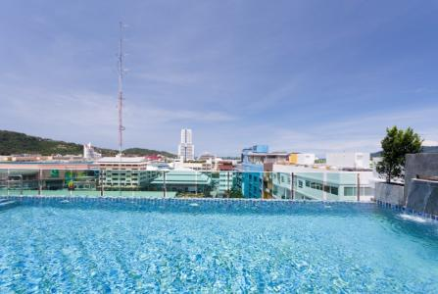
Rooftop Swimming Pool
Opening Hours: 08.00 am – 10.00 pm.
Our fabulous roof-top swimming pool offers our guests with a refreshing way to relax after a long day of sightseeing. Along with a beautiful view of Patong beach area's skyline, the swimming pool is the perfect place to enjoy yourself.
Our swimming pool uses a natural salt-water purification system instead of harmful chemicals which provides cleaner and safer water for you and your loved ones to enjoy, even for those with more sensitive skin.

Slide 15
Oceana Function room
Oceana room has been fitted to be suited for small meetings and smaller gatherings. The meeting and catering room is located at the rooftop floor offering breath-taking view of infinity edge pool and Patong beach area’s skyline. Complete with big screen flat television and the high end speakers and stereo equipment.
BANQUET CAPICITY ACCORDING TO ROOM SET UPS
Rooms | Area | Height | Theatre | Classroom | “U” Shape | Karaoke room | Cocktail
Oceana Function room | 72 m2 | 4 m | 40 | 24 | 16 | 20 | 30

Slide 16
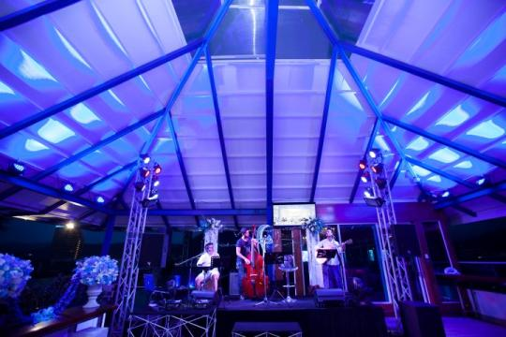
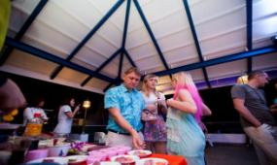
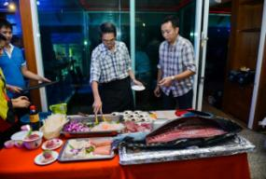
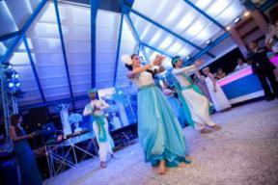
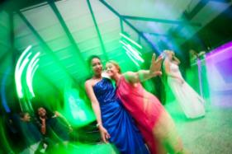
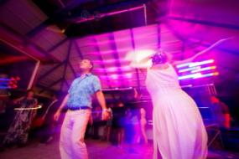
Event gallery @ Oceana Pool Bar

Slide 17
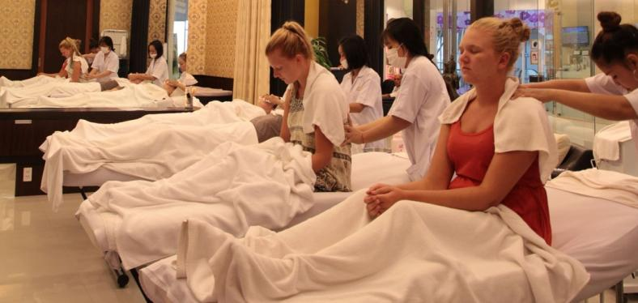
Sira Spa
Opening Hours: 10.00 am – 10.00 pm.
Sira Spa offers a variety of different spa and massage therapy treatments. Bring wellness into your life, with tempting spa rituals featuring time tested beauty techniques alongside the latest treatments.
A wide variety of treatments are available such as: facials spa, traditional massages, pedicures, manicures, aroma therapies, steams, sauna and much more. Plus, all of our treatments are custom tailored for your unique skin.

Slide 18

It’s your Grande style!
www.siragrandhotel.com
Tel : +66 (0)76 540 991
Email: info@siragrandhotel.com

