Slide 1

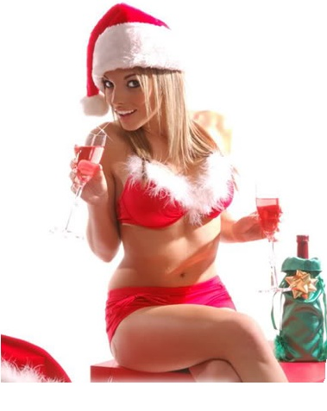
CHRISTMAS PROGRAM
11.30h Animation Kid’s Xmas Parade at the beach area
15.00h Santa clause distribute the presents for Children in our amphitheater
……………………………..
18.00h
Reception Cocktail
19.00h
Buffet opening time
19.00h
Live band
21.00h
Belly dancer show
21.00h
Xmas Tombola
22.00h
Live band

