Slide 1
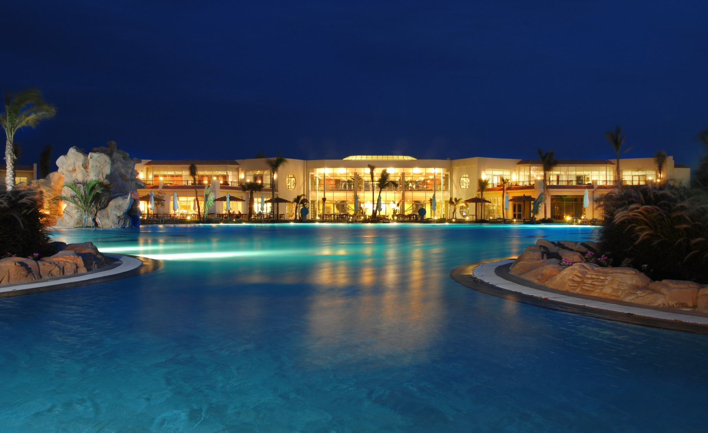
WELCOME TO HILTON SHARKS BAY Ras Nusrani, Sharks Bay, Sharm EL Sheikh, 203, Egypt TEL: 20-69-360-3333

Slide 2
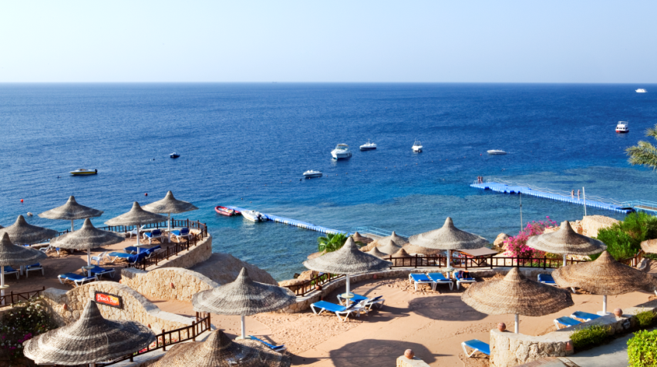
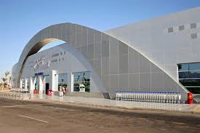
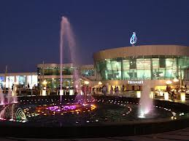
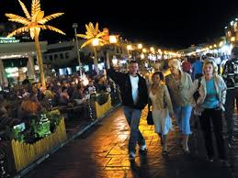
5 min drive from Sharm el Sheikh international Airport .
The resort is in walking distance to SOHO SQUARE.
Only 15 min drive to downtown Naama Bay.
Hotel Shuttle bus available

Slide 3
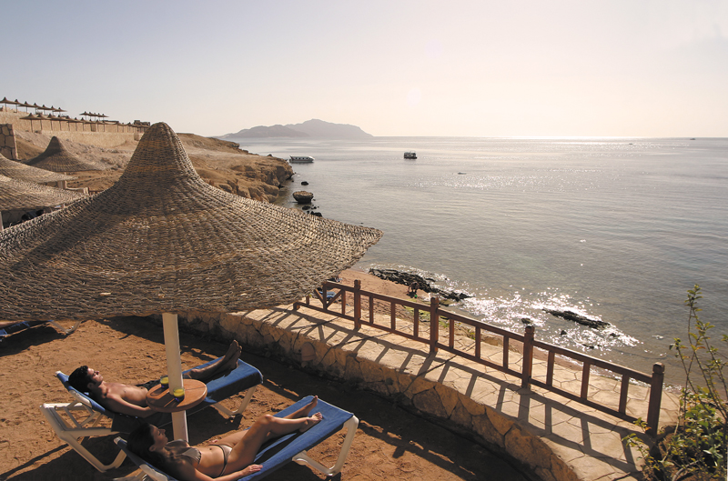
Hilton Sharks Bay Resort offers a variety of 13 Restaurants and Bars, a private Beach, 7 pools and 629 newly refurbished guestrooms and suites.
It has an onsite diving centre, medical clinic, shopping arcades, mini golf course, tennis court, pools with slides and 2 kids clubs.

Slide 4
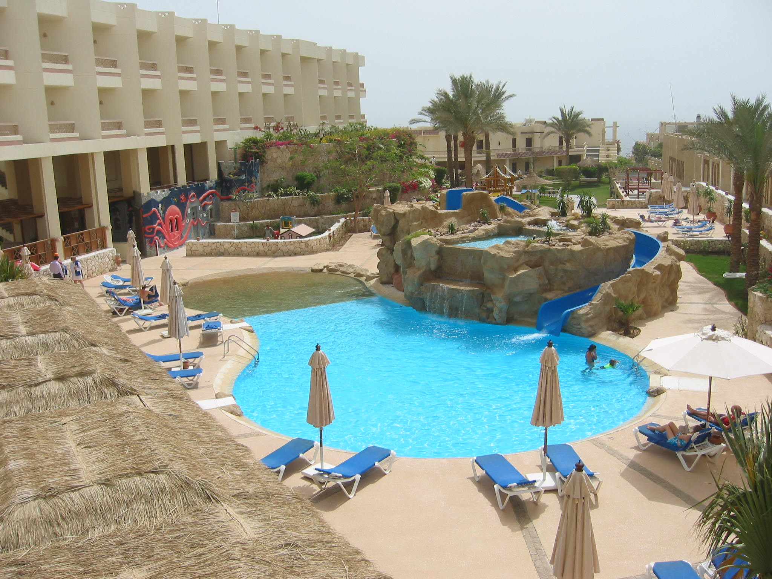
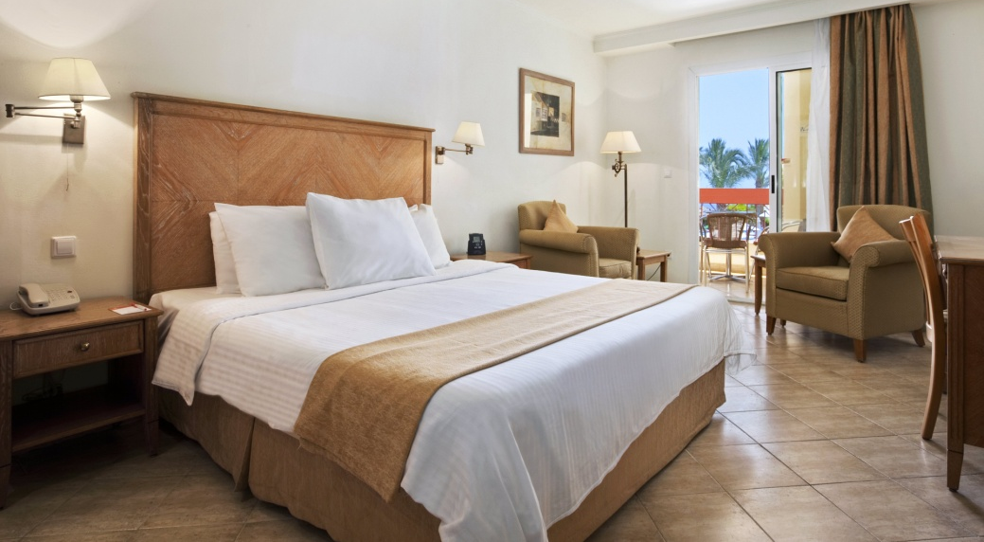
Standard Room
This Art Deco-style 28m²/301sq.ft room with a balcony or terrace in cool has 1 king bed. Some rooms have a garden view and some have large, opening windows. Maximum occupancy 2 adults, 1 child.

Slide 5
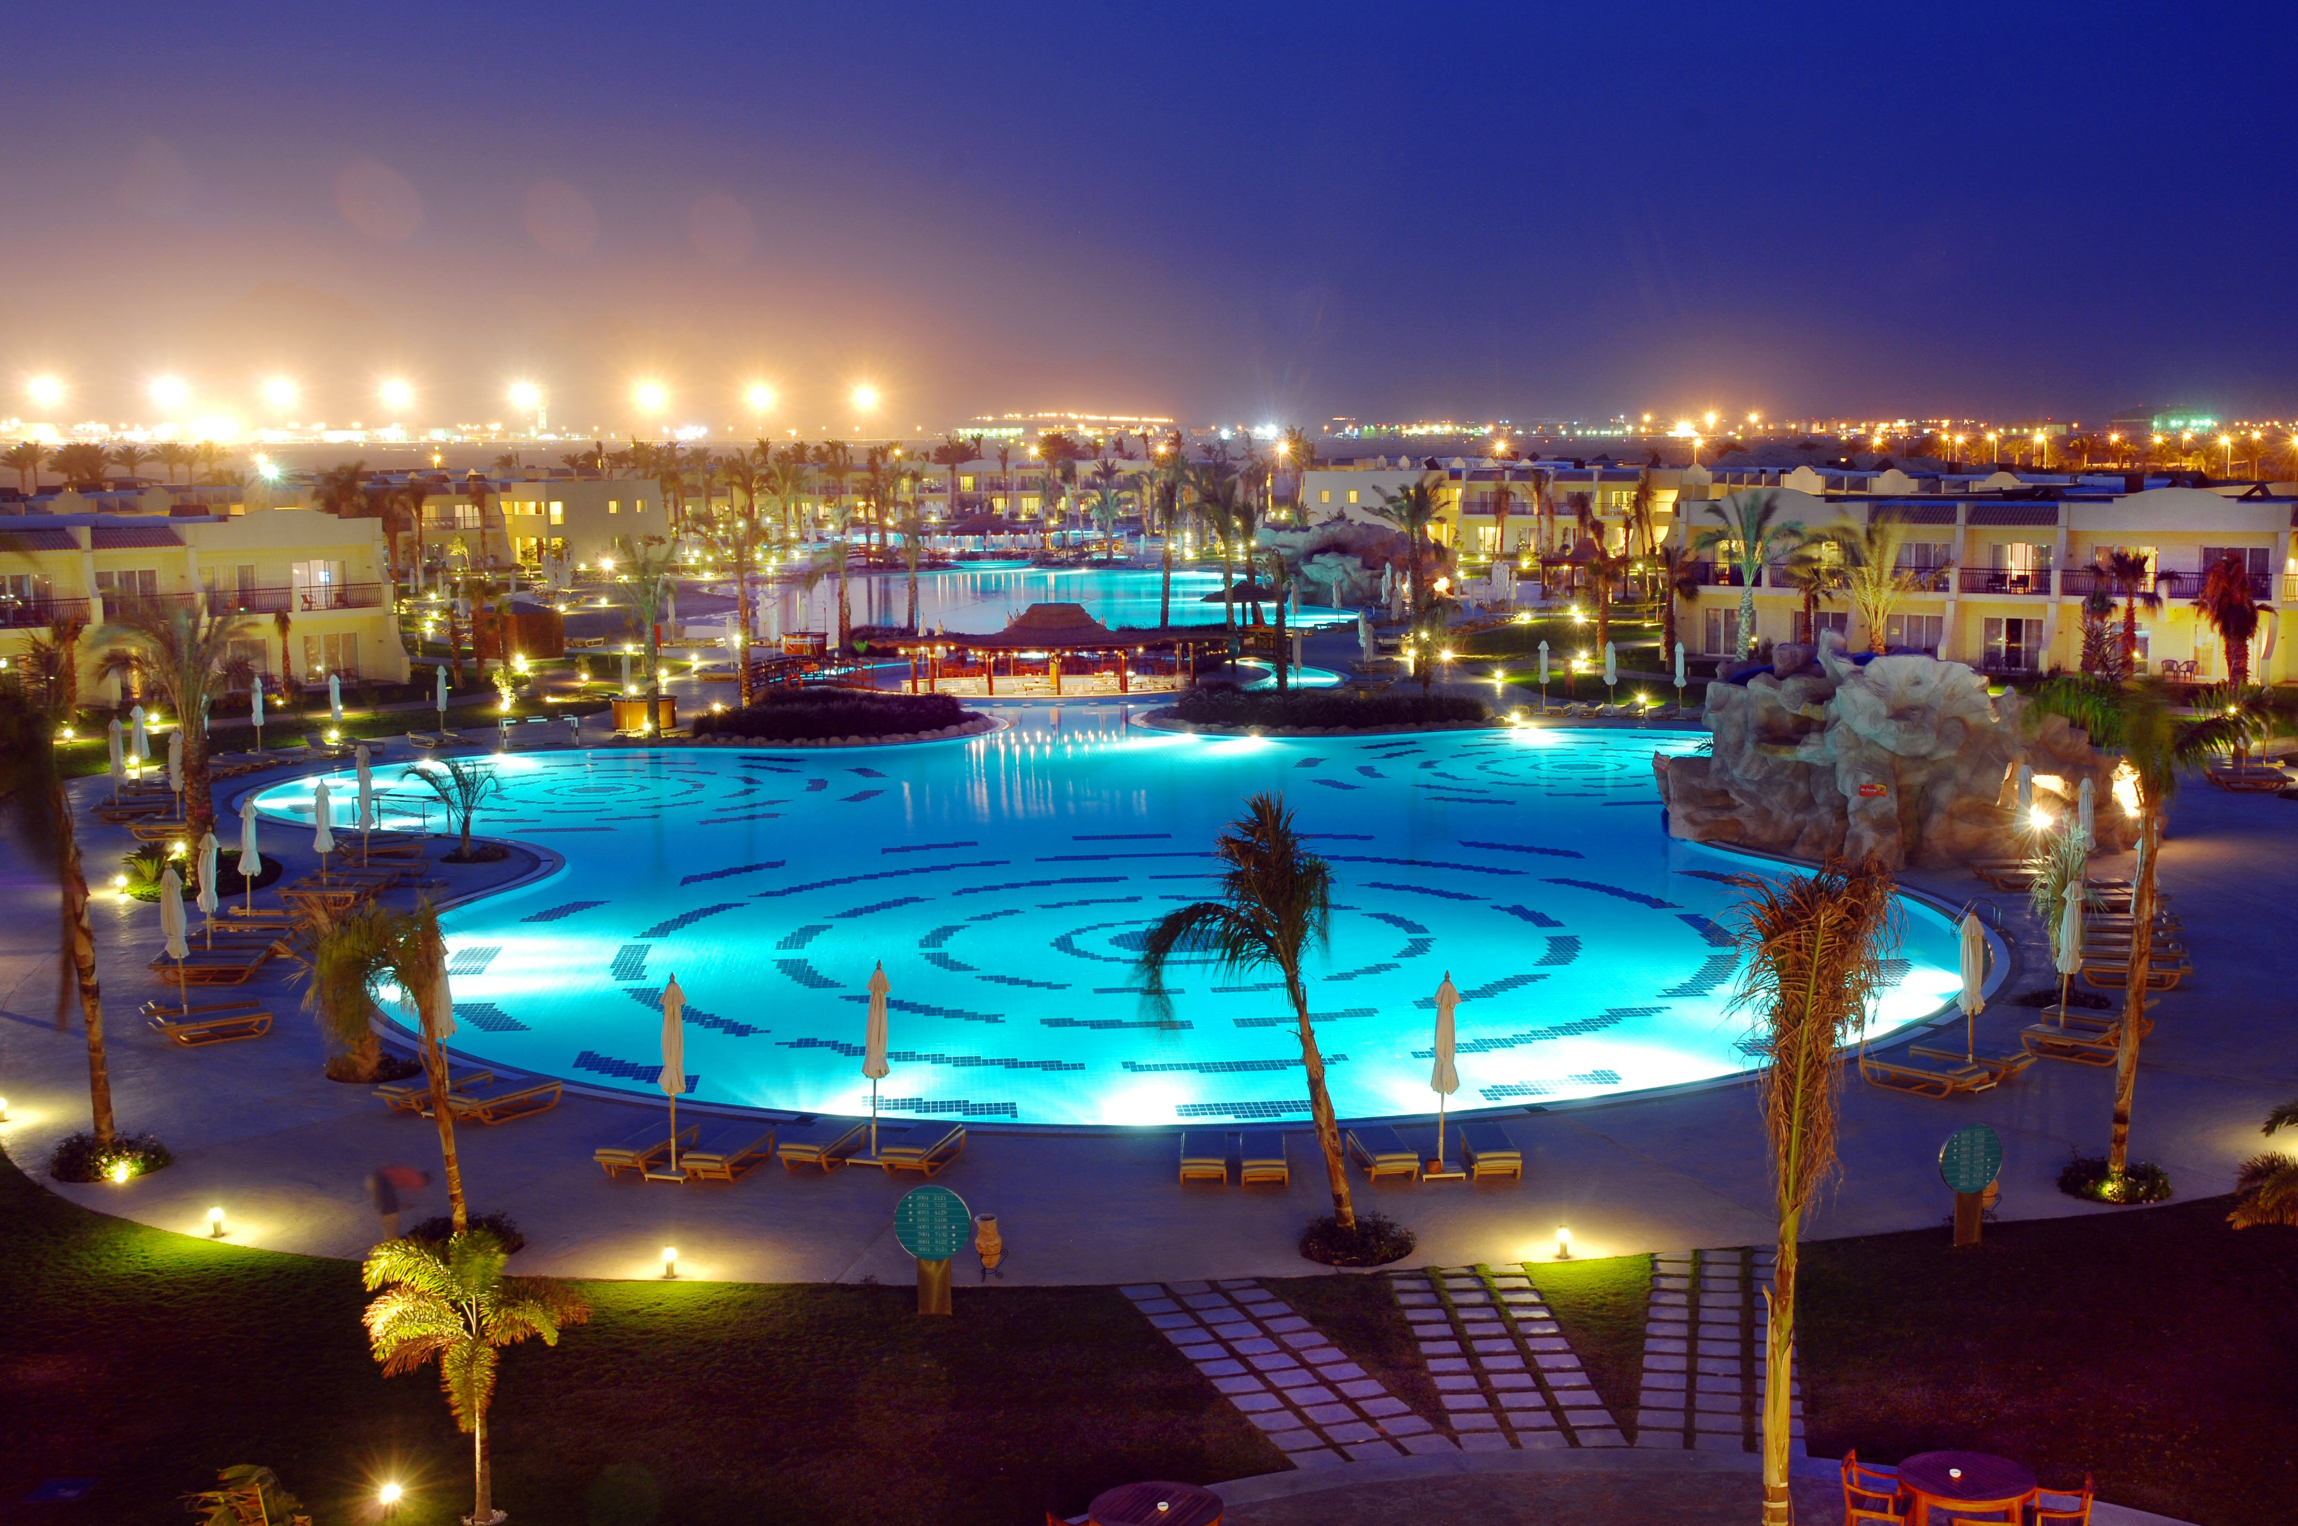
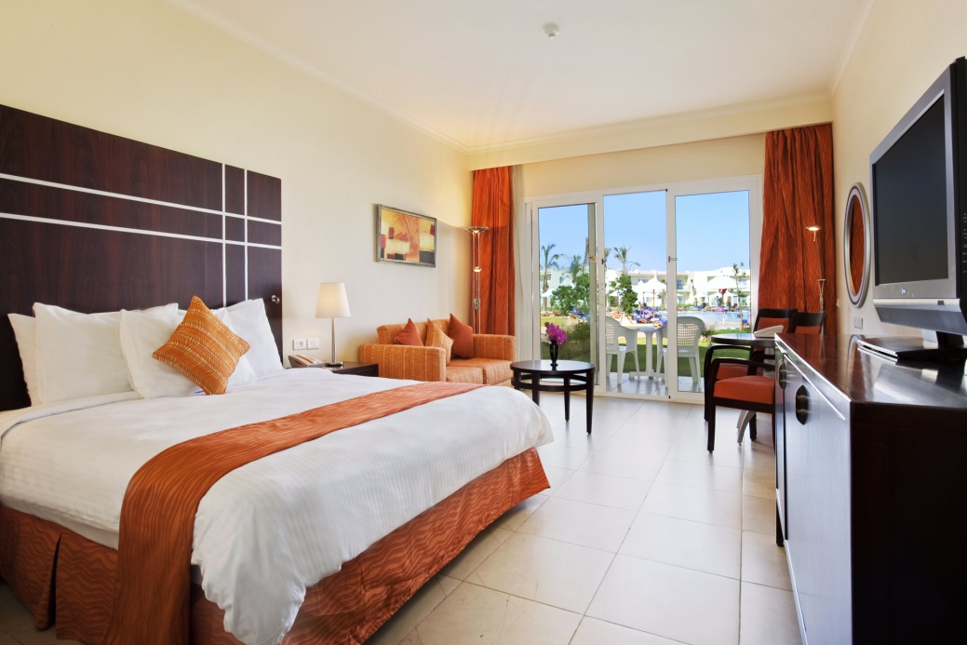
Deluxe Room
This 41m²/440sq.ft Deluxe room offering a seating area with sofa and direct access to a relaxing terrace and pool area. The spacious room, in cool, calm tones, has 1 king bed and a sofa bed. Catch up on work at the desk or relax and enjoy the beautiful views. Maximum occupancy 2 adults, 2 children (under 7 years).

Slide 6
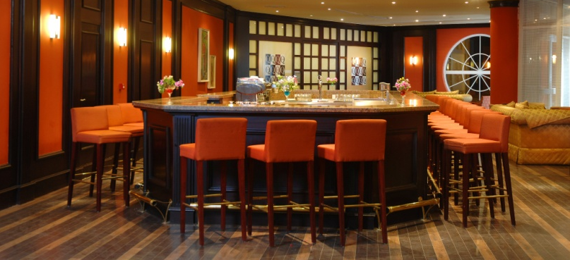
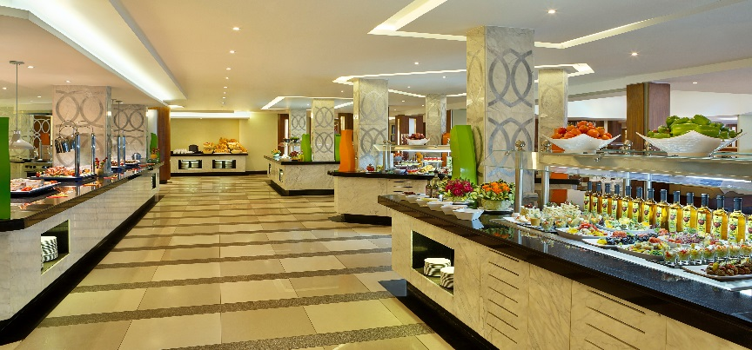
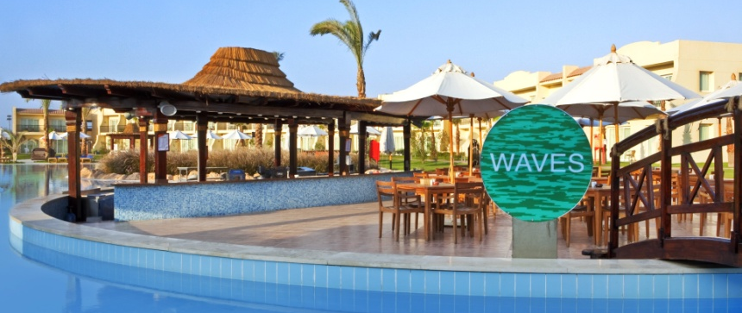
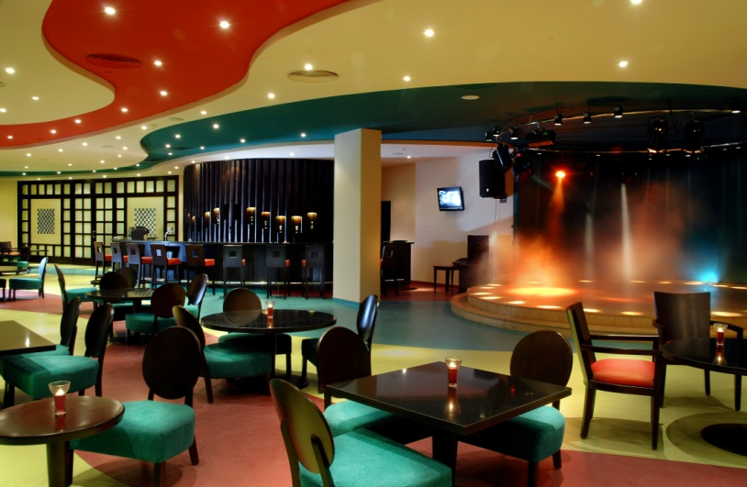
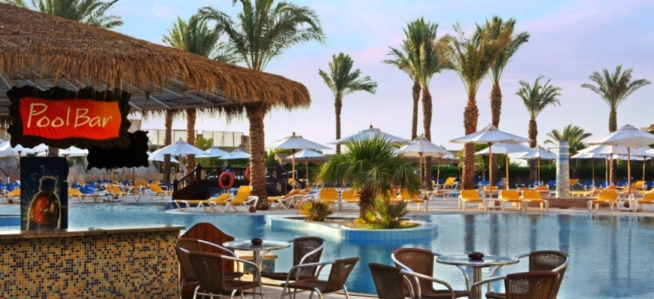
Hilton Sharks Bay offers a various range of international cuisines as part of all inclusive and a la carte.
11
Bars are accessible all day and open until sunset.
Daily Entertainment and Animation Program is provided for all age.
Please review AI formula for full update on the All inclusive concept of Hilton Sharks Bay.

