Slide 1
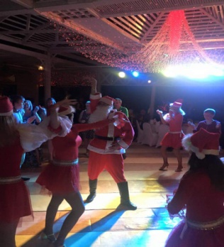
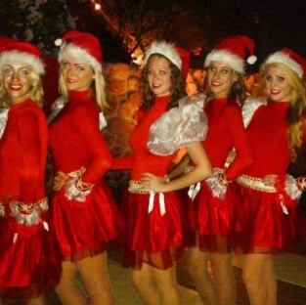
Christmas
Program
Sunday 24th Of December 2017
ITALIAN RESTAURANT
Come along with your little ones and enjoy the Christmas Eve to start celebration period.
At 19:00
Christmas Dinner
Live Music from 19:30 – 22:00
At 20:00 Christmas Santa Clause Show
Special guest : Santa Clause
At 23:30
Belly Dance Show
Normandy II
For Table reservation please contact Guest Relation Desk

